Slide 1
IMPLEMENTING
CONTROLLER VIEW METHODS

Slide 2




BHUVANESH NAKKA
RAJESH KAMMARI
VAMSHI KRISHNA REDDY
YEDALLA
Valentine osakwe

Slide 3
What to learn at the end of this:
CREATE
EDIT
DELETE
LIST
DETAILS
Web Application- MVC

Slide 4
Web Application
Web Application is a client Server computer program which the client (including the user interface and client-side logic) runs in a web browser .
The Model–view–controller shortly known as MVC is a software architectural design for implementing user interfaces on computers.
MVC patterns separate input, processing, and output of an application.

Slide 5
In MVC pattern, application and its development are divided into three interconnected parts.
The advantage of this is it helps in focusing on a specific part of the
Application the ways information is presented to and accepted from,
the user.
It helps in allowing for efficient code reuse and the parallel development
Of the application.

Slide 6
Model: Model represents the structure of data,the format and the constraints with which it is stored. It maintains the data of the application. Essentially, it is the database part of the application.
const CustomerSchema = new mongoose.Schema({
_id: { type: Number, required: true },
email: { type: String, required: true, unique: true },
given: { type: String, required: true, default: 'Given' },
family: { type: String, required: true, default: 'Family' },
accountNumber: { type: String, required: true, default: '' },
transactionType: { type: String, required: false, default: '' },
amount: { type: String, required: true, default: '' },
})
module.exports = mongoose.model('Customer', CustomerSchema)

Slide 7
VIEWS
View: View is what is presented to the user.Views utilize the Model and present data in a form in which the user wants.
A user can also be allowed to make changes to the data presented to the user.
They consist of static and dynamic pages which are rendered or sent to the user when the user requests them.
Everything the user will see. Basically the pages that we’re going to send to the client.

Slide 8
CONTROLLERS
Controller:Controller controls the requests of the user and then generates appropriate response which is fed to the viewer.
The user interacts with the View, which in turn generates the appropriate request,this request will be handled by a controller.
The controller renders the appropriate view with the model data as a response.
Model is data part.
View is User Interface part. Controller is request-response handler.

Slide 9
CREATE
// GET create
api.get('/create', (req, res) => {
LOG.info(`Handling GET /create${req}`)
const item = new Model()
LOG.debug(JSON.stringify(item))
res.render('customer/create',
{
title: 'Create customer',
layout: 'layout.ejs',
customer: item
})
})
Calls create create.ejs in customer.

Slide 10
DELETE
// GET /delete/:id
api.get('/delete/:id', (req, res) => {
LOG.info(`Handling GET /delete/:id ${req}`)
const id = parseInt(req.params.id)
const data = req.app.locals.customers.query
const item = find(data, { _id: id })
if (!item) { return res.end(notfoundstring) }
LOG.info(`RETURNING VIEW FOR ${JSON.stringify(item)}`)
return res.render('customer/delete.ejs',
{
title: 'Delete customer',
layout: 'layout.ejs',
customer: item
})
})
It calls the Delete.ejs

Slide 11
DETAILS
// GET /details/:id
api.get('/details/:id', (req, res) => {
LOG.info(`Handling GET /details/:id ${req}`)
const id = parseInt(req.params.id)
const data = req.app.locals.customers.query
const item = find(data, { _id: id })
if (!item) { return res.end(notfoundstring) }
LOG.info(`RETURNING VIEW FOR ${JSON.stringify(item)}`)
return res.render('customer/details.ejs',
{
title: 'customer Details',
layout: 'layout.ejs',
customer: item
})
})

Slide 12
EDIT
// GET one
api.get('/edit/:id', (req, res) => {
LOG.info(`Handling GET /edit/:id ${req}`)
const id = parseInt(req.params.id)
const data = req.app.locals.customers.query
const item = find(data, { _id: id })
if (!item) { return res.end(notfoundstring) }
LOG.info(`RETURNING VIEW FOR${JSON.stringify(item)}`)
return res.render('customer/edit.ejs',
{
title: 'customers',
layout: 'layout.ejs',
customer: item
})
})

Slide 13
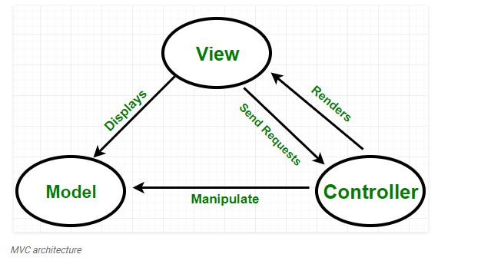
Source : geeksforgeeks

Slide 14
Get views to display for CRUD (show fields)
Index api.get('/'
Create api.get('/create'
Delete api.get('/delete/:id'
Details api.get('/details/:id'
Edit api.get('/edit/:id'

Slide 15
ANY QUERIES?

Slide 16

THANK YOU!

